Slide 1
Content
What is VPN
Types of VPN’s
How does it work?
Protocols
Security: Firewalls
VPN Devices
Advantages
Disadvantages
Features
Future
Conclusion

Slide 2
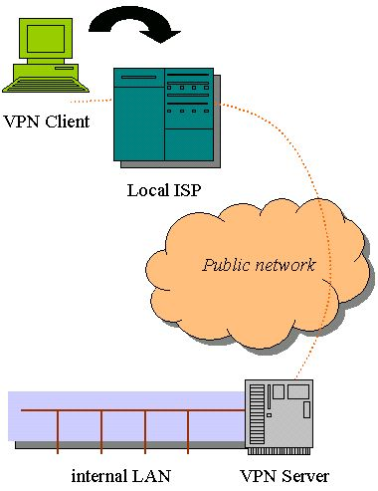
What is VPN
Virtual Private Network is a type of private network that uses public telecommunication, such as the Internet, instead of leased lines to communicate.
Became popular as more employees worked in remote locations.
Terminologies to understand how VPNs work.

Slide 3
Types of VPN’s
Remote-Access VPN
Site-to-Site VPN (Intranet-based)
Site-to-Site VPN (Extranet-based)

Slide 4
Remote-Access VPN
A remote access VPN is for home or travelling users who need to access their central LAN from a remote location.
They dial their ISP and connect over the internet to the LAN.
This is made possible by installing a client software program on the remote user’s laptop or PC that deals with the encryption and decryption of the VPN traffic between itself and the VPN gateway on the central LAN.

Slide 5
Site-to-Site VPN
Intranet-based - If a company has one or more remote locations that they wish to join in a single private network, they can create an intranet VPN to connect LAN to LAN.
Extranet-based - When a company has a close relationship with another company (for example, a partner, supplier or customer), they can build an extranet VPN that connects LAN to LAN, and that allows all of the various companies to work in a shared environment.

Slide 6
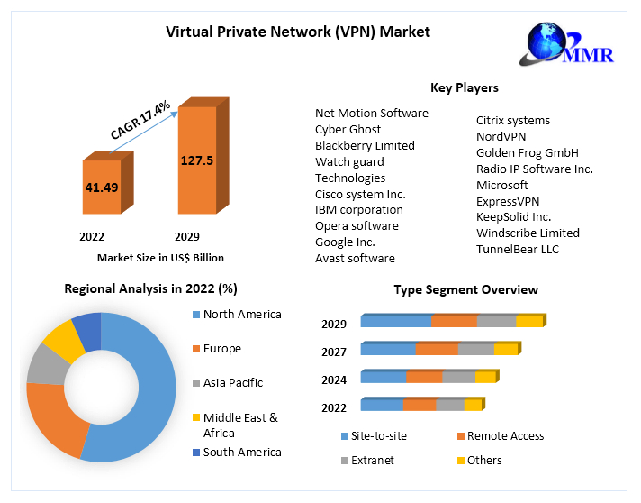
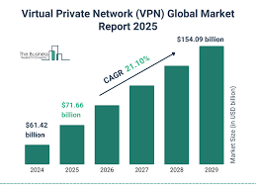


VPN information
2030
2028
2026
2024

Slide 7
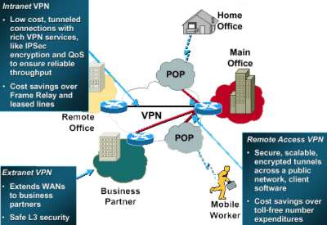
All 3 types of VPN

Slide 8
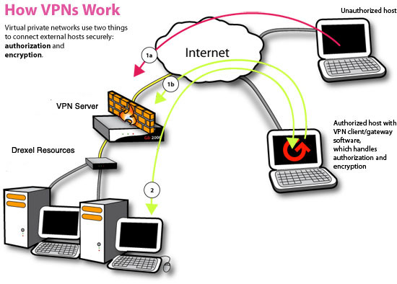

Slide 9

VPN work

Slide 10
Protocols used in VPN
PPTP - Point-to-point tunneling protocol
L2Tp – Layers to Tunneling Protocol
IPSec - Internet protocol security
SSL – Secure socket layer
Encryption- Non human readable

Slide 11
VPN Security: Firewall
A well-designed VPN uses several methods for keeping your connection and data secure:
Firewalls
Encryption
IPSec
AAA Server
(Authonatication,authorization,accounting)

Slide 12
Type of Firewalls
Network-based firewalls:
Host-based firewalls:

Slide 13
Type of Encryption
OpenVPN:
IPsec (Internet Protocol Security):

Slide 14
VPN Devices
Hardware
Firewall
Software

Slide 15
Hardware
There are several types of hardware devices that can be used for VPN connectivity:
VPN Routers
Firewalls with VPN Support
VPN Concentrators
VPN-enabled NAS (Network Attached Storage)
VPN-capable Modems
VPN-capable Smart Home Devices

Slide 16
Firewall
Hardware Firewall with VPN Support:
VPN Concentrators:
VPN-enabled Routers:
Software Firewalls with VPN Support:
Virtual Firewalls and VPN Appliances:
Cloud-based Firewalls and VPN Services:

Slide 17
Software
Client Software:
Router Firmware:

Slide 18
VPN Advantages
Enhanced Security
Privacy
Access to Restricted Content
Remote Access
Improved Performance
Anonymity
Safe Public Wi-F
Cost-Effective

Slide 19
VPN Disadvantage
Slower Internet Speed
Cost
Complexity
Limited Access
Security Risks
Privacy Concerns
Device Compatibility
Legal and Regulatory Issues

Slide 20
VPN Features
Public Wi-Fi Security
Scalability
Services
Management
Kill Switch:
Multiple Device Support:
DNS Leak Protection:

Slide 21
Future of VPN
VPN popularity
  Companies choosing VPN
  Cost efficient?
  New way of communicating?

Slide 22
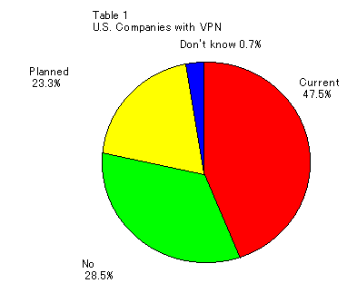
Future of VPN: Companies with VPN

Slide 23
Conclusion
As we have gone through all possible details we conclude that VPN is the best option for the corporate networking.
As many companies need to have access to Internet and hence security is also the main concern.
VPN provides best possible combination of security and private network capabilities with adequate cost –saving to the companies who are presently working with leased lines.

Slide 24
Referance
www.google.com
www.chatgtp.com

Slide 25
THANK YOU

